Slide 1
AlumnIUB - a social networking site to connect alumni and students
Presentation by Group - 29

Slide 2

Problem Statement
Introducing AlumnIUB
In general, universities are not practicing what they teach when it comes to their former customers- their alumni. In short, they are failing in alumni engagement and networking. We know about the importance of alumni engagement for alumni relations offices at colleges, universities, and other institutions around the country and across the world
This is where ‘AlumnIUB’ seeks to make a difference by linking Alumni with other Alumni, Students and University. Users can seek for help and connect with other alumni also can share their experience on that application.

Slide 3
Goals and objectives
To create a database to store information about students who already graduated from IUB.
To store information of their other social media information of Facebook, Email and LinkedIn to connect.
To share their achievements.
If new graduates need any help regards finding new jobs, then they can ask for mentorship from their alumni.
For the information database, university can invite alumni of IUB for any events and seminars so that they can share their experience with all the new students.
To donate for social cause, Charity, raising money for any individuals or fellow IUBians with health conditions.

Slide 4
Problem solution and objective
Problem | Solution
New graduates are struggling in their new workplace. | Through the app, they could connect with alumni and seek advice
No data and relevant analytics about alumni | Alumni data will be collected from app ( with prior consent) and build customized and significant alumni experiences at scale using data analytics, sophisticated segmentation, and marketing automation.
Difficult for university to track all the alumni’s information | All data of users are kept in AlumnIUB database (with proper security)

Slide 5
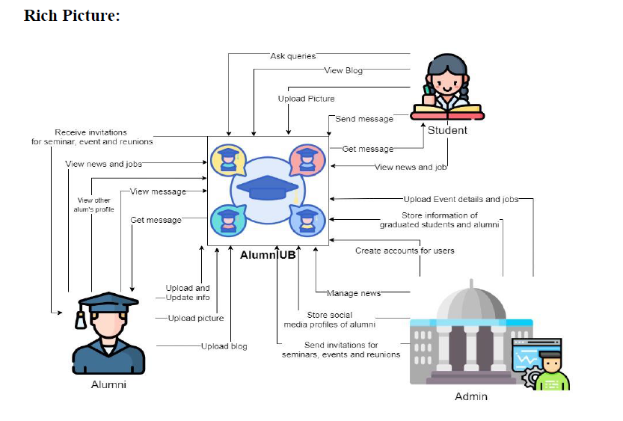
Analysing and Designing Features

Slide 6
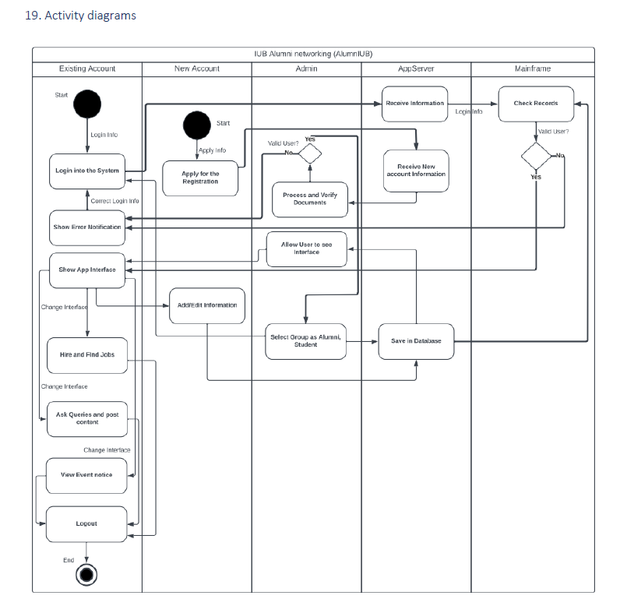

Activity
Diagram

Slide 7
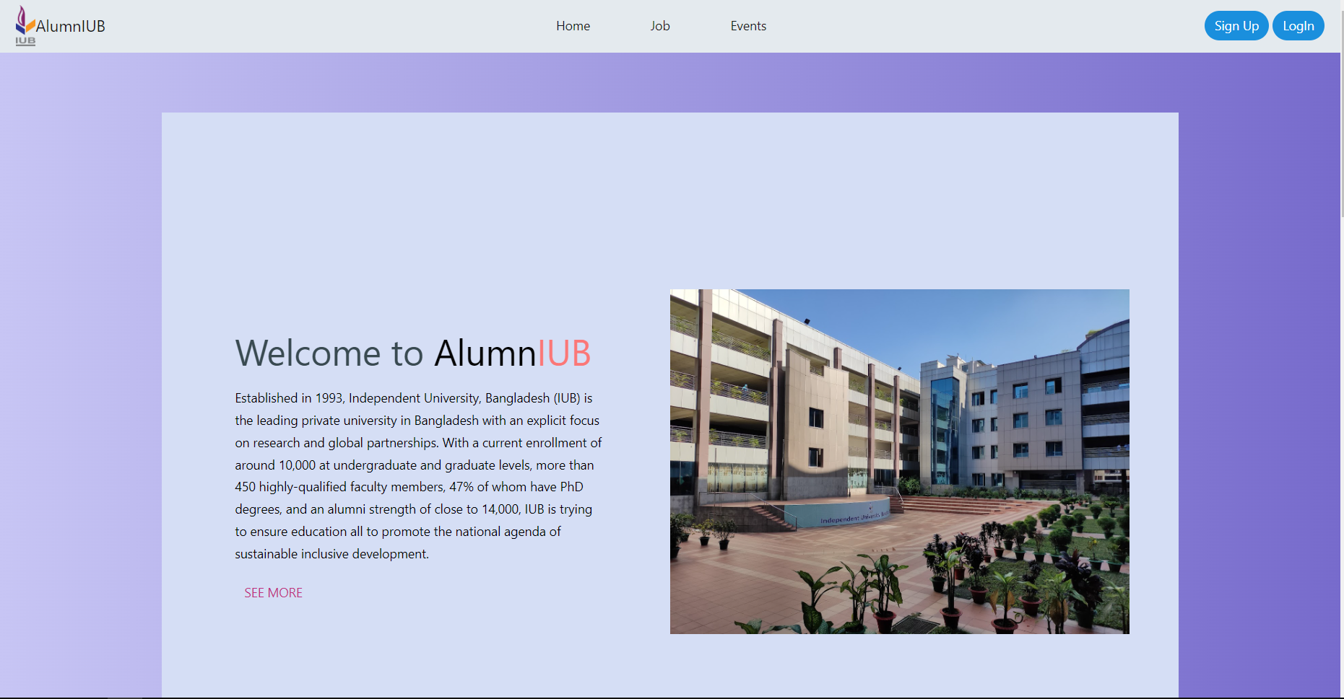
Screenshots of the prototype

Slide 8
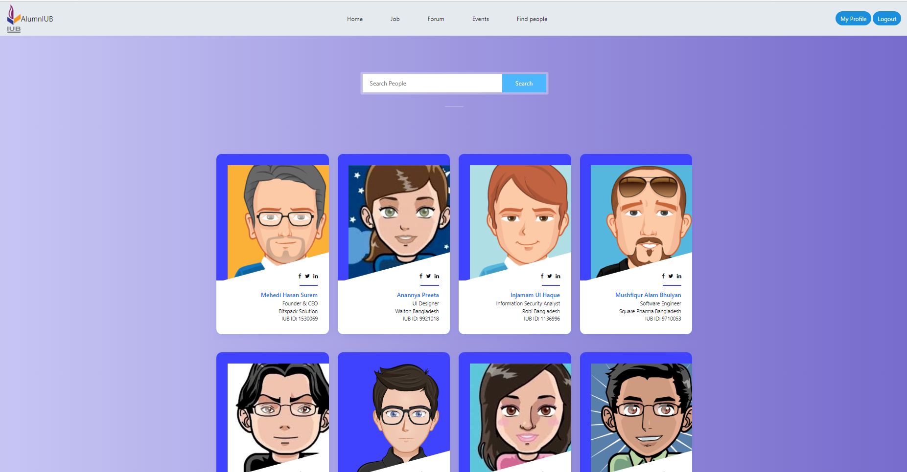
Screenshots of the prototype

Slide 9
Thank you!
Project and Presentation by Group: 29
Ayatullah Arefin - 2022353
Syed Niaz Mohtasim-2021607
Fahim Shahriar-2022523
Mehedi Hasan Surem-2030069

